Slide 2
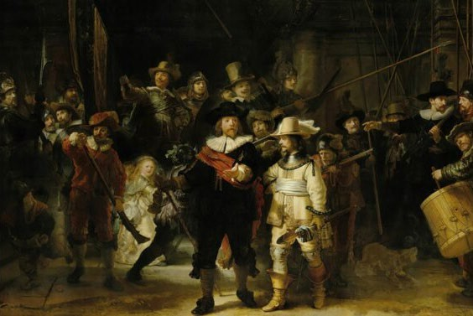
Rijksmuseum:
The ‘Musketeers of District II led by captain Frans Banninck Cocq, known as the “Night Watch”’ (‘Schutters van wijk II onder leiding van kapitein Frans Banninck Cocq, bekend als de “Nachtwacht”’), 1642

Slide 3
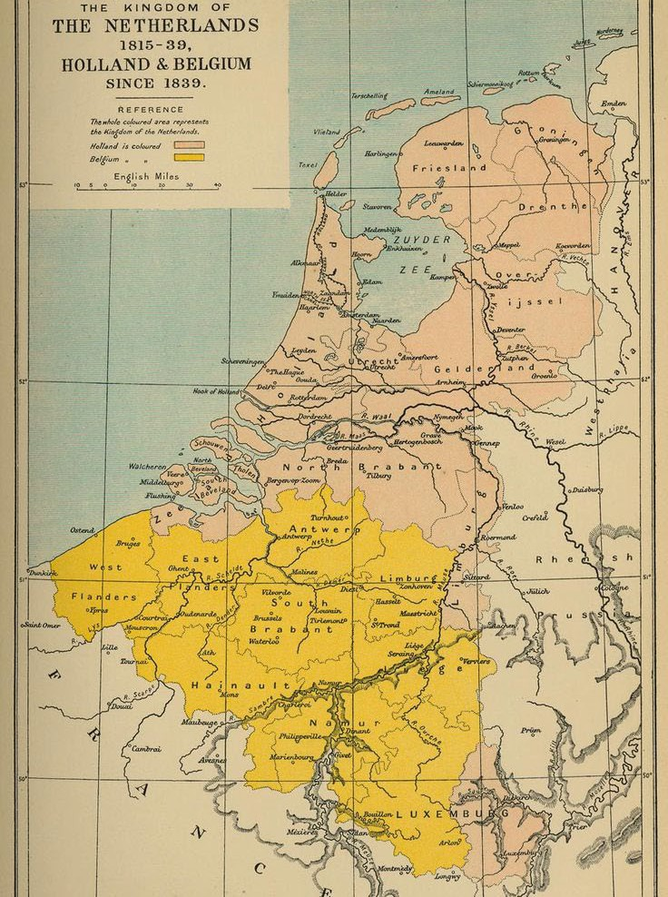

Slide 4
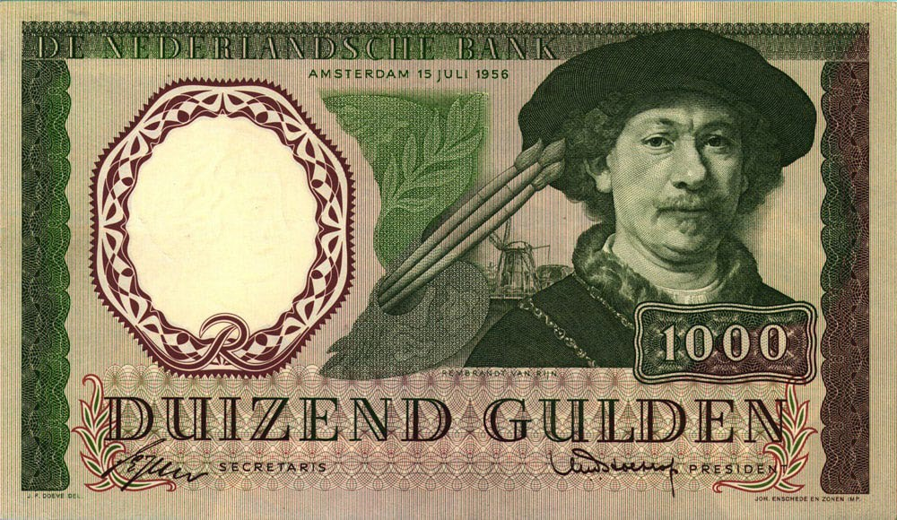

Slide 5
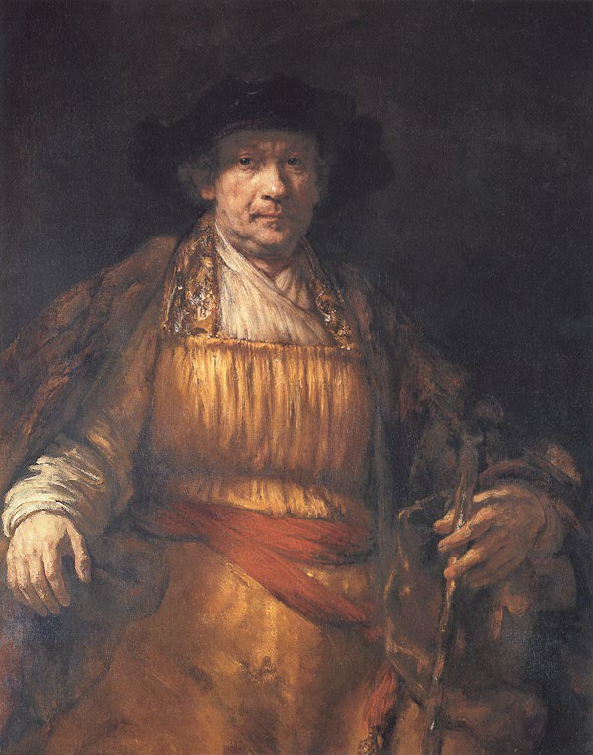

Slide 8
Archives:
No diary; no personal archives; incomplete ‘public’ archives
Paper trail: approx. 150 individual documents in archives (courts, tax registers, notarial archives in Leiden, The Hague, Leeuwarden and Amsterdam)
Legal acts, around 80: agreements, receipts, wills of parents, Saskia, Titus; buying/selling plot of land, loans/investments
Legal disputes, approx. 25 legal conflicts/battles of all kinds, with patrons (quality of work; sharp business practices/prices), with neighbor (re costs of reconstruction house), ‘panic’ loans , not paying rent for auction room, ‘transfer’ of house ‘to detriment of creditors’, arbitration, insolvency proceedings, ‘company’ between Hendrickje and Titus, rent arrears for his last house

Slide 9
A legal-financial case study interpreting situations for which direct evidence is available, in light of the applicable law in those days in ‘Holland’. Presented with insights in the
societal developments in this stage in the development of the Netherlands today (political, religion, migration/demography, trade, culture, growing of city-state Amsterdam)
What I do not cover
1 No 'new facts', rather another look at Rembrandt as an entrepreneur and businessman, explaining and discussing these aspects, attaching interpretations to them where possible 2 Case study, consulting mostly ‘compilations of primary sources’
Rembrandt Documents (Strauss/Van der Meulen 1979)
Hofstede de Groot (‘Urkunden’ 1906)
Not the 'dark side' of the Dutch Golden Age
No illustrations, no iconography, no 'psychological analysis' of Rembrandt

Slide 11
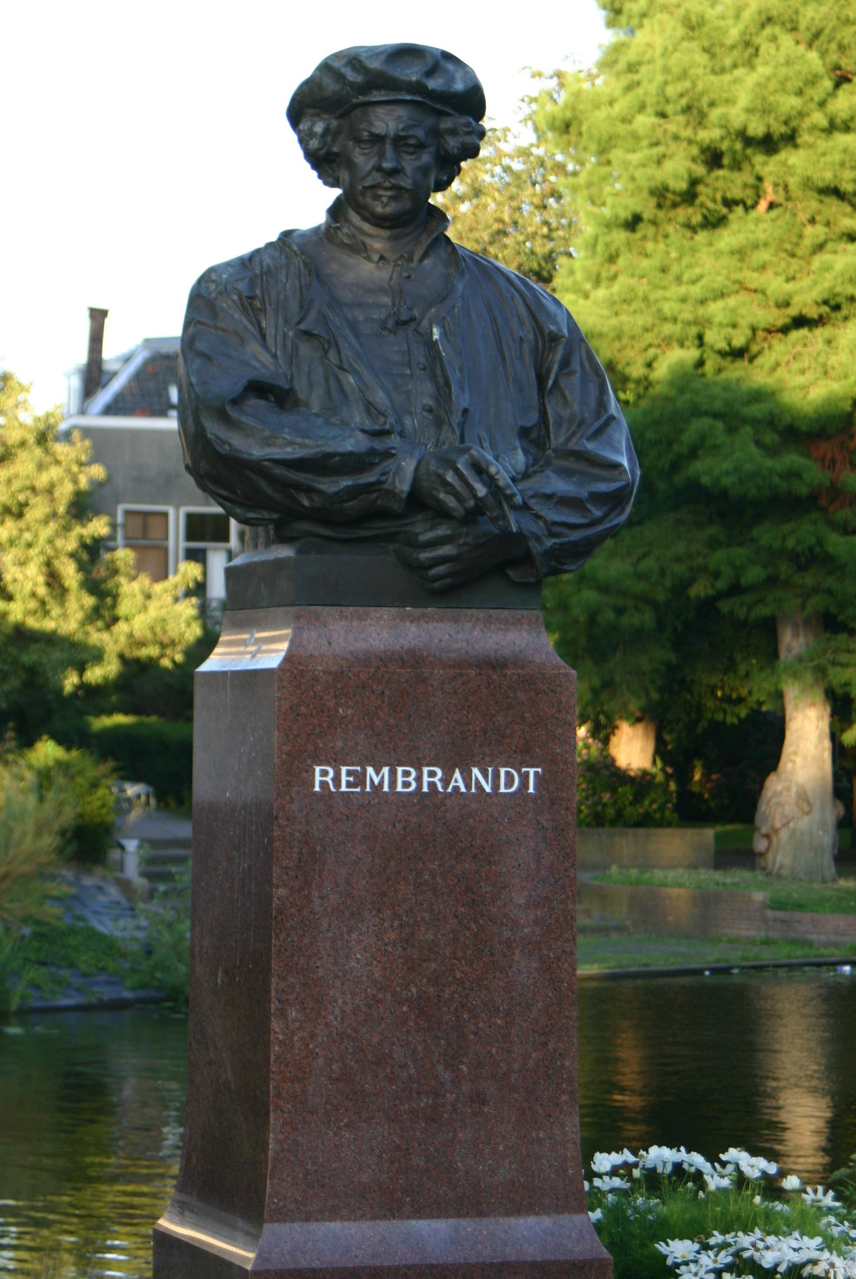

Slide 12
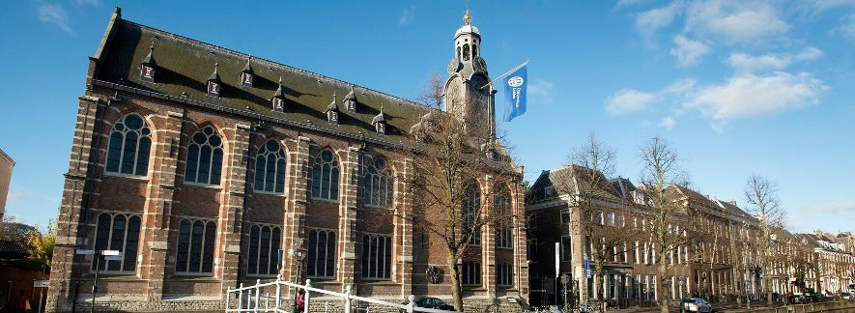

Slide 13
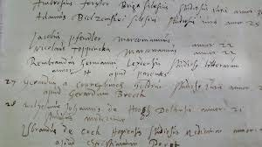

Slide 14
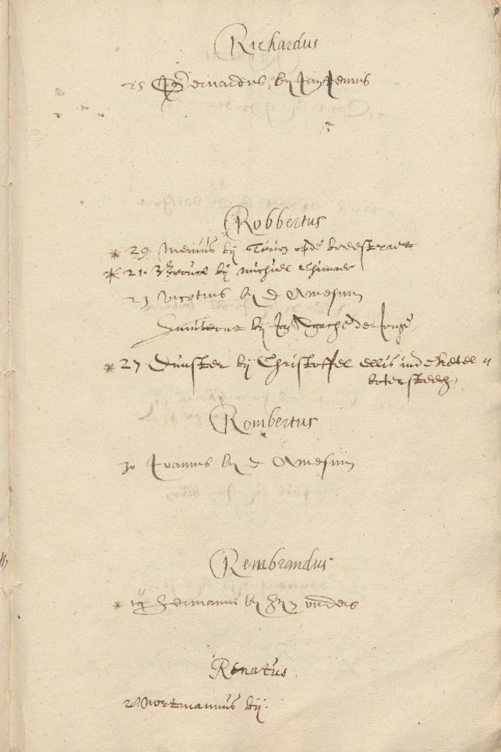
‘Rembrandus’, with underneath: ‘
‘* 14 15 Hermanni bij sijn ouders’

Slide 15
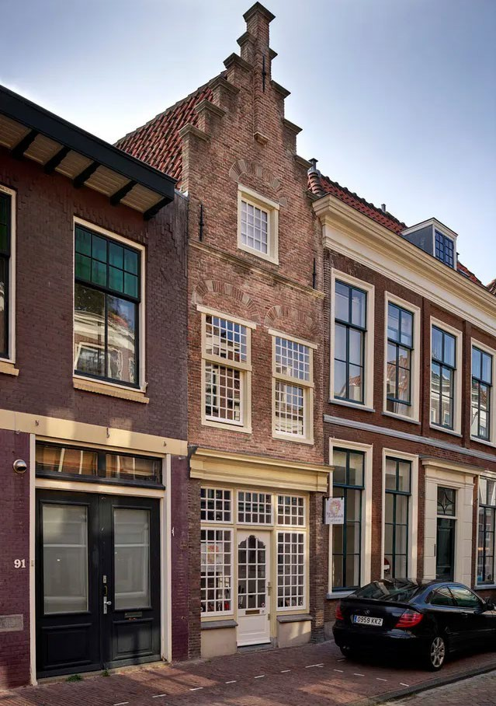

Slide 16
Dr. Stephanie Dickey, in: CODART September 2021:
‘By the time Rembrandt was in his mid-twenties, he had established a thriving art practice in Leiden, as displayed recently in Young Rembrandt: Rising Star. He could surely have remained there and built a career as one of his hometown’s leading artists. Yet, around 1632, he chose to relocate to Amsterdam, the commercial hub of the nascent Dutch Republic.’
Bikker (2019): ‘In short, Leiden was no place for an up and coming start like Rembrandt. It was time to move on’
Blom (2019): ‘… he was ready’

Slide 17
Artist in rather small houses of his parents; no room for 'large size' commissions
His contemporary Jan Lievens had large Leiden clients, Rembrandt just had a few
Rembrandt had Remonstrant protectors; Leiden was fiercely against 'Arminianism’
Leiden: poor market conditions; he charged high fees
In 1628 R starts etching (no previous training); his paintings didn’t sell?
In Leiden no St Luke's guild, so no protection against outsiders, but also no 'quality benchmark’
Early 1630s: several painters left Leiden, including De Heem (Antwerp), Lievens (London) and Jan van Goyen (The Hague)
Father died in 1930; family were millers or backers; no personal reason to stay

Slide 20
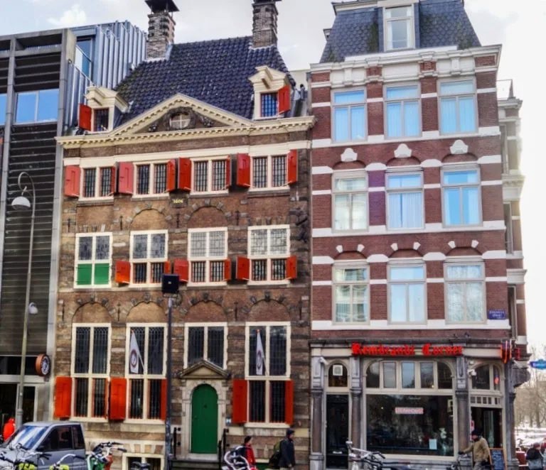

Slide 21
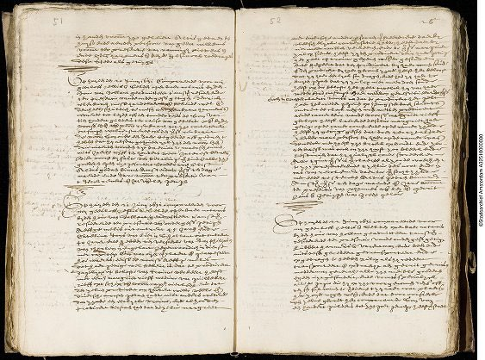

Slide 22
document/remdoc/e4393
[Summary]
Today, on 20 June 1631, appeared before me, Geerloff Jellisz Selden, public notary ... [mr.] Henrick Ulenburch, art dealer, and confirmed that he owes Rembrant Harmensz, a resident of Leiden, or any subsequent holder of the title, the sum of 1000 guilders lent to the aformentioned Henrick Ulenburch by the above-mentioned Rembrant. In case the aformentioned Rembrant demands to be repaid within the period of one year, he must give the aformentioned Ulenburch notice three months in advance.

Slide 23
Op huyden den 20 Juny 1631 compareerde voor mij Geerloff Jellisz Selden, openbaer notaris … Henrick Ulenburch, cunsthandelaer, ende bekende wel ende deuchdelijck schuldich te wesen aen Rembrant Harmensz wonende tot Leyden, off den toonder deses, de som van tienhondert guldens ter cause van geleende penningen bij den voorsz. [Henrick Ulenburch] van den voorn. Rembrant , tot zijn contentement ontfangen, welverstaende off den voorz. Rembrant de voorn. som over een jaer begeerde affgedaen te hebben, dat hij alsdan gehouden zal zijn, den voorn. [Henrick Ulenburch] drie maenden voor den tijt daervan te waerschouwen, mits jaerlijcks vijff ten hondert voor interest betalende. Hier vooren bij fante van betalinge verbindende alle zijn goederen geen uytgesondert. Sonder arch ende list. Aldus gedaen binnen Amsterdam voors. ten dage maende ende jare voorn. ter presentie van Tjerck Remers ende Jan van dey getugen

Slide 24
It could, hypothetically, also reflect
the payment for the use of a location in the studio to work, or
a tacid partial pre-payment reflecting an oral agreement (compare the use in the 21st century of a ‘side-letter’) between Rembrandt and Hendrick that the former would acquire an exclusive position in Hendrick’s studio (without others knowing it), or
payment for the assurance to Rembrandt he would receive a certain number of assignments, or
representing a contribution (in capital) brought into a partnership (‘firma’) against Hendrick’s non-cash contribution in work and diligence (‘arbeid en vlijt’).

Slide 25
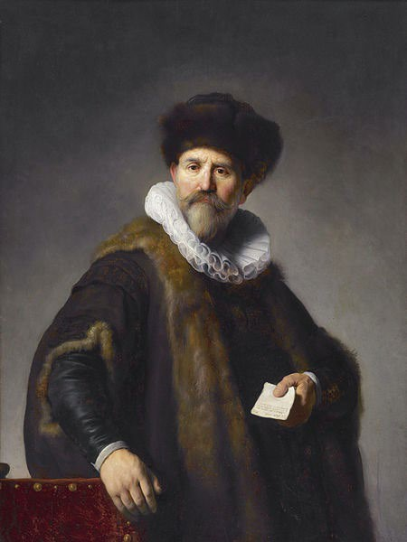

Slide 26
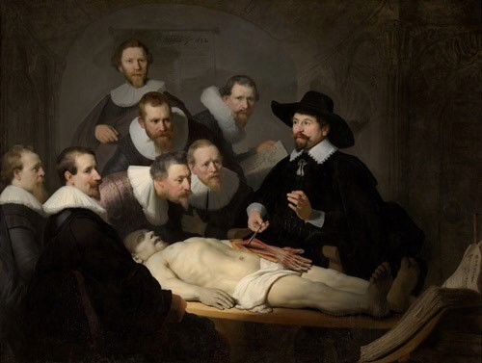

Slide 27
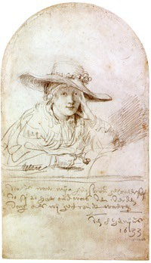

Slide 28
Onderschrift:
‘… dit is naer mijn huijsvrou geconterfeijt do sij 21 jaer oudt was den derden dach als wij getroudt waeren, den 8 Junijus 1633’
Caption:
‘… this is my wife, portrayed when she was 21 years old the third day that we were married, the 8th of June 1633’

Slide 29
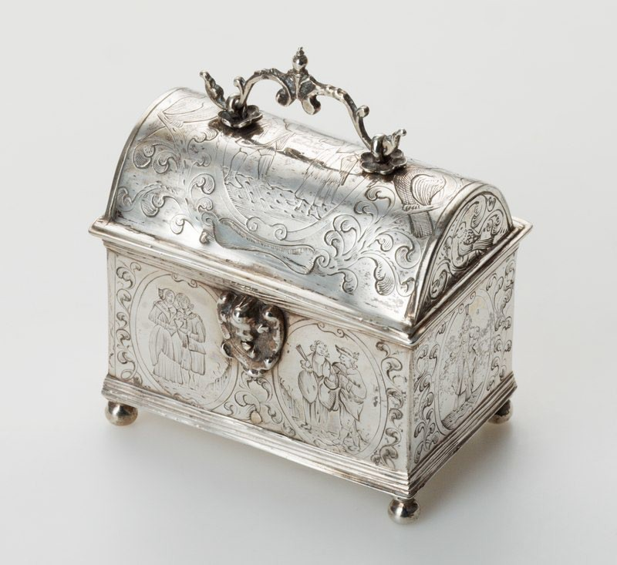
Knottekistje (Zuiderzeemuseum)
Wedding casket

Slide 31
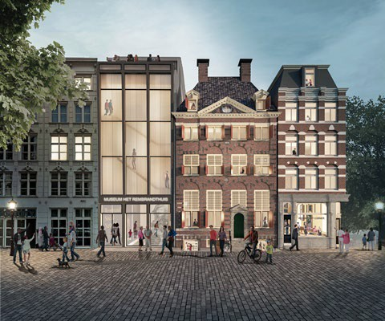
Rembrandthuis

Slide 32
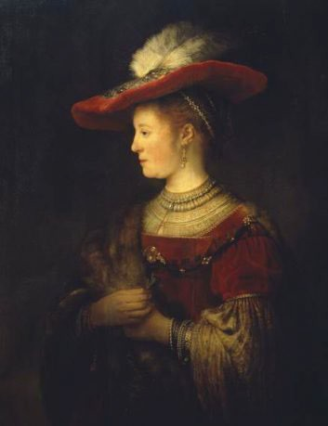

Slide 33
Rijksmuseum:
The ‘Musketeers of District II led by captain Frans Banninck Cocq, known as the “Night Watch”’ (‘Schutters van wijk II onder leiding van kapitein Frans Banninck Cocq, bekend als de “Nachtwacht”’), 1642

Slide 35
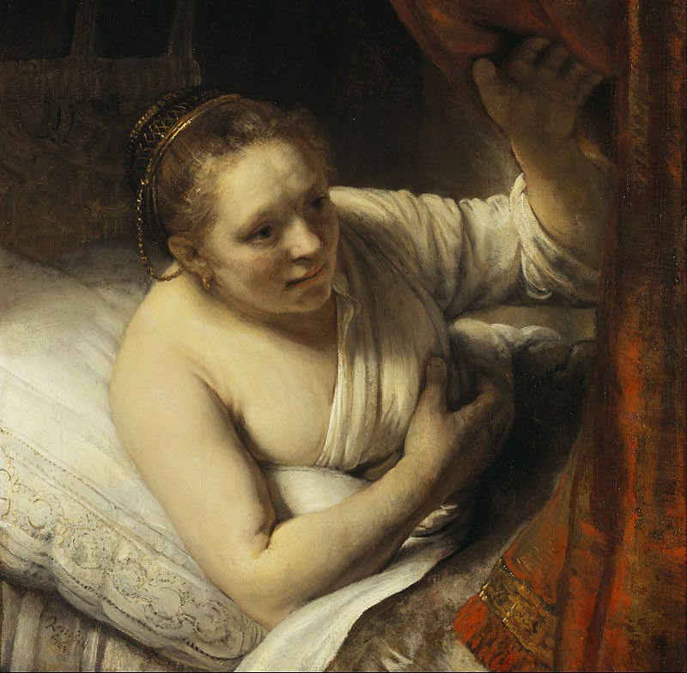

Slide 37
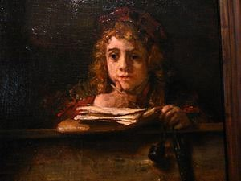

Slide 39
Will of Saskia, 5 June 1642; she passes away 14 July 1642, still 29 years old:
‘… hoewel sieck te bedde leggende, nochtans haer memorie ende verstand wel gebruijkende als ‘t uiterlyck bleeck’ … ‘haere erfgenamen’ … Titus van Rhijn, ‘haeren soon’,
…‘met die conditie nochtans’ … ‘dat Rembrant van Rhijn, hare man, tot heruwens, ofte niet heruwende tot stervens toe, in volle possessie ende vruchtgebruik van alle hare testatrices naertelatene goederen sal blijven sitten;’
Although sick in bed, yet was in full control of her memory and mind, as it appeared outwardly
‘her heirs’ … Titus van Rhijn, ‘her son’ … ‘under the condition however’… that Rembrandt van Rhijn, her husband, until remarrying, or when not remarrying, until his death will, have possession and usufruct of all her … goods.

Slide 40
Den 17. May 1656 heeft Rembrant van Rhijn, schilder bewesen sijnen soone Titus, out 15 jaer daer moeder af was Saskia Uylenburch, voor sijn moeders erf[fenisse] een huijs ende erf, staende ende gelegen op de Antony breestraet, vrij sonder eenige belastinge. ende dat bij provisie ter tijden ende wijlen hij hem wederom ten tweeden houwelijck soude mogen comen te begeven, als wanneer hy den voors. synen soone syn volle moeder erf[fenisse], ende sal ondertusschen de voors. synen soone houden met behouden goede sal bewijsen tot sijne iaren toe omme de vruchten van dien, ende tot bevrijdinge van de schulden ende lasten, op het voors. huys geaffecteert, verbonden alle syne goederen, roerende ende onroerende , praesente ende toecomende, des sal bij provisie voorts blijven sitten in alle de andere goederen, schulden ende inschulden; ende dit op het behagen van de moeders vrunden. Prae[sentibus] de heeren Hendrick Spiegel ende Jan van Waveren, Wees[meesteren].

Slide 41
On 17 May 1656, Rembrandt van Rhijn, painter, has assigned to his son Titus, 15 years of age, whose mother was Saskia van Uylenburgh, as his mother's legacy, a house and ground standing and situated on Anthonybreestraat, fee of any encumberments.
And with this proviso, if he should marry a second time, he shall assign his [Titus'] entire legacy left by his mother to here aforementioned son. Meanwhile he shall support him, until he comes of age, with the benefits accruing therefrom. And in order to free the house from indebtedness and obligations encumbering it, he pledges all his possessions, movable and immovable, present and future.
According to these provisions, Rembrandt shall continue to administer all the other property, debts and claims and this with the [expected] consent of his [Titus'] maternal relatives.
In the presence of Messr. Hendrick Spiegel and Jan van Waveren, commissioners of the Chamber of Orphans.

Slide 42
5 possible interpretations:
1 - neutrale betekenis / neutral expression
R demonstrating (to Weeskamer/Orphan Chamber) he is owner/has possession of the house?
2 – idem/ditto
Mere ascription (tenaamstelling of medetenaamstelling) of house to Titus?

Slide 44
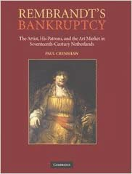

Slide 45
Crenshaw (2006) [writes] … just two weeks after ‘… Rembrandt’s maneuver with the Weeskamer’, in which Rembrandt ‘… clearly attempted to escape his obligations to his creditors’, a ‘… new law was passed in Amsterdam’, which ‘… was amended shortly after he applied for cessio bonorum’.
Crenshaw: ‘These new regulations prevented citizens from bringing goods to the Weeskamer and assigning them to their children prior to declaring bankruptcy’ …
‘In other words, Rembrandt’s transfer of property to his son was legal at the moment that he did it, but ran so contrary to customary and accepted practice that it was quickly outlawed’.

Slide 46
This view is clearly dismissed:
built on the false assumption that the title to the house (right of ownership) had passed to Titus
based on an inaccurate reading of the ‘new law’ (i.e. a ‘keur’, a city statute)
this ‘statute’ clearly relates to a different situation, namely the case in which the entire estate belongs to the surviving parent and, on the other hand, this parent pays a sum of money to the children, i.e. a buyout sum (uitkoop) (‘by forme van uitkoop, namelijk, dat de langstlevende blijft zitten in den geheelen Boedel alleen, mits …’). In such a case, the child as an heir would have remained fully liable towards the creditors of the estate. The statute does not relate to the situation in which action is taken by way of partitioning the common goods (‘niet bij schiftinge en scheidinge der goederen zelfs’).
the aforementioned statute has nothing to do with Rembrandt’s cessio bonorum.

Slide 47
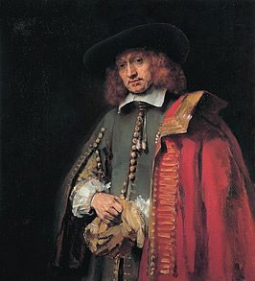

Slide 48
Legal melting pot, including canon law, Roman law, legislative collections like the Great Placard books, collections of jurisprudence, opinions of legal authors and the publications of Hugo de Groot (Grotius)
This mixed legal system of law in Holland, the result of the growth of an uncoordinated set of rules and principles, is referred to as Roman-Dutch law, a term still used today in South Africa
In 1638 the Court of Holland, Zeeland, and West-Friesland, decided that the Costumen of the city of Antwerp 1582 should be introduced ‘… in our territory and other countries, where trade and business are prevailing’ (‘… dat de selve Costumen in patria nostra en andere landen, daer de negotie en koopmanschap vigeren’)
Amsterdam Ordinance 1643 (followed by new Ordinance 1659, in force till 1777) applied to insolvency matters

Slide 49
In this area of law, the Amsterdam Chamber of Abandoned and Insolvent Estates (Desolate Boedelskamer) had a specific role; in today’s terms it would be a partly administrative, partly legal institution
Commissioners (5-7); appointment of ‘curateur’ Torquinius
Commissioners: roughly half had legal background (not being judges), others were regents/merchants
Note: its territorial jurisdiction?
Note: 6 September 1956 appointment by Orphan’s Chamber
(‘Weescamer’) of Jan Verwout, as guardian of Titus, succeeded as guardian by Louis Crayers, 4 April 1658

Slide 50
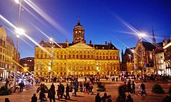

Slide 51
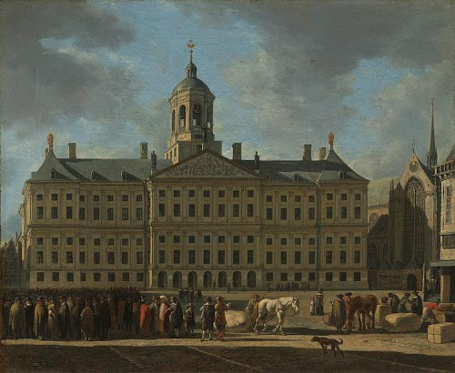

Slide 52
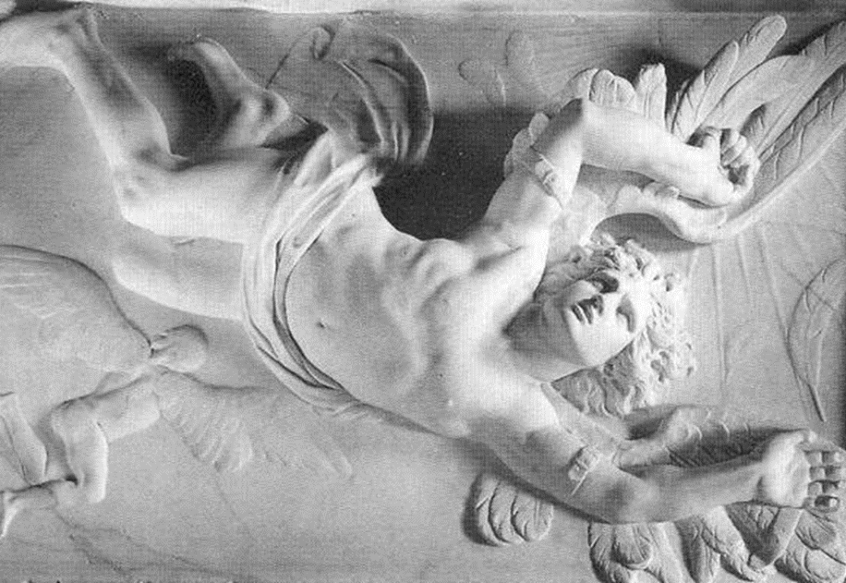

Slide 53
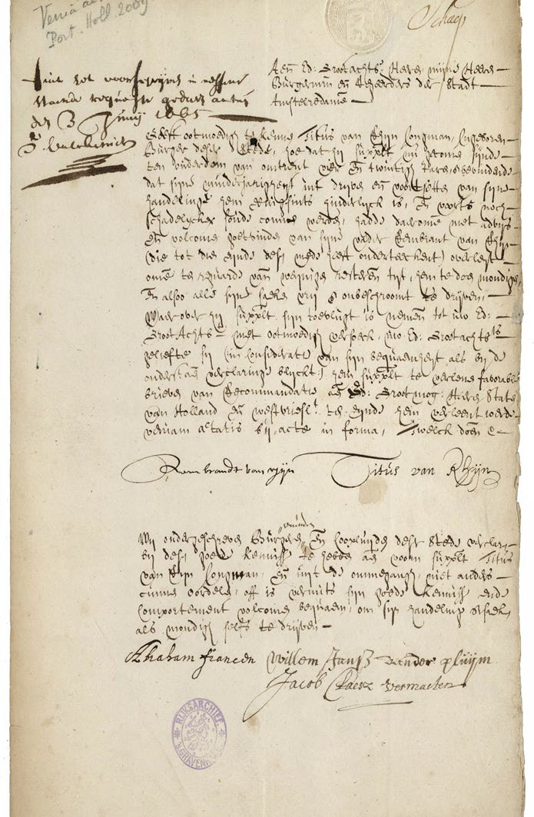
Verzoekschrift tot cessio bonorum (‘boedelafstand’) , 14 juli 1656
Application for cessio bonorum , 14 July 1656

Slide 54
document/remdoc/e4704
document/remdoc/e4704

Slide 55
Aen de Hooghe Overicheijt
Geeft reverentelick te kennen Rembrant van Rijn woonende tot Amsterdam dat hij suppliant door verliesen geleden in de negotie alsmede schaden ende verliesen bij der zee in soodanigen ongelegentheijt is geraeckt, dat hem niet mogelijck is sijne crediteuren te konnen voldoen, ende alsoo deselve sijne crediteuren met naemen d'Heer Burgemr. Cornelis Witsen, Isaacq van Hertsbeecq, Mr. Daniel Francen, Gerbant Ornia, Hiskia van Vuijlenburch, Geert Dircx, Gerrit Boelissen, ende andere wel behoorden daer op reguardt te nemen, is het echter sulcx dat hij wert gedreijcht van de selve te sullen werden overvallen, oirseacke waeromme den suppliant genootsaeckt is sich te addresseren aen U Ho. Overicheijt oijtmoedelick versouckende brieven van cessie, met committimus aen den Gerechte van Amsterdam, d'welck doende recht
N. Geltsack
[i.m.] Fiat advijs aen Burgemeesteren ende Regeerders van Amsterdam, gedaen in den Hoogen Rade in den Haghe desen xviiii Julij 1656, Iman Cau.
Gesien de rescriptie fiat mandement van cessie ende committimus aen de Gerechte van Amsterdam. Gedaan in den hoogen Rade van Hollant desen viii Augustii 1656, Iam Cau.

Slide 56
To the High Court
Rembrant van Rijn, residing in Amsterdam, respectfully acknowledges that he, the applicant, due to losses suffered in business, as well as damages and losses at sea, has come into so much difficulty that it is impossible for him to pay his creditors, and therefore these creditors, namely Burgomaster Cornelis Witsen, Isaacq van Hersbeecq, Mr. Daniel Francen, Gerbrandt Ornia, Hiskia van Vuijlenburch, Geert Dircx, Gerrit Boelissen, and others should take this into consideration, the situation being that he is exposed to surprise threats by the aforementioned, for which reason the applicant is obliged to address himself to Your Hon.
Magistracy and humbly petition for a letter a cession, the jurisdiction to be transferred to the Amsterdam Court,
H. Geltsack 1656
[in margin:] [1] Disposition: asked the advice of the burgomasters and magistrates of Amsterdam. Enacted by the High Court of the Hague, 14 July 1656. Iman Cau.
[2] As a consequence of the reply received, letters of cessio granted with transfer of the jurisdiction to the Court of Amsterdam. Enacted by the High Court of Hollant 8 August 1656.

Slide 57
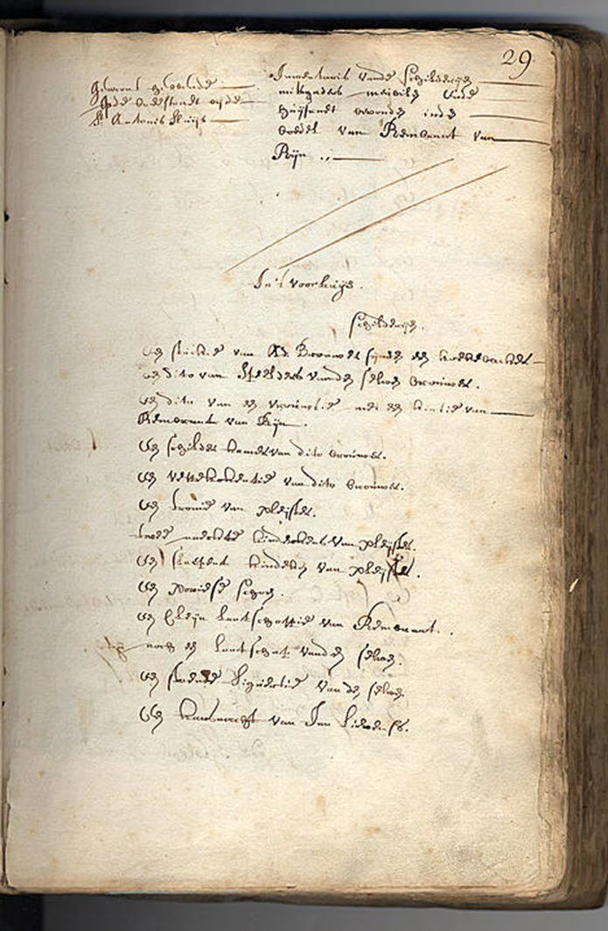
Boedelbeschrijving 25 en 26 juli 1656
Inventory of estate 25 and 26 July 1956

Slide 58
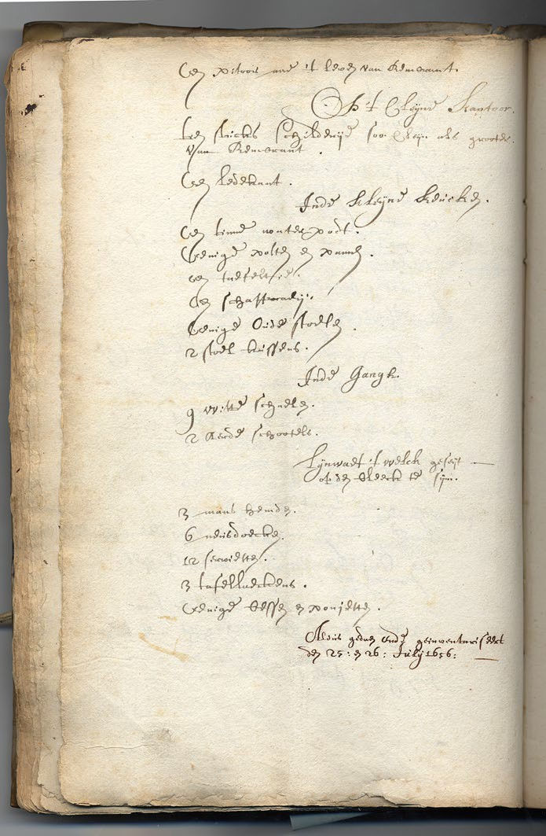
Laatste pagina (p. 20)
Last page (p. 20)

Slide 59
Dutch text
‘door verliesen geleden in de negotie'
'alsmede schade ende verliesen bij der zee’
‘wert gedreijcht van de selve te sullen werden overvallen’
Causes
‘due to losses suffered in business'
'as well as damages and losses at sea’
'threatened by his creditors to be captured'
Comparison:
‘negotie’, in general means ‘trade’. Was Rembrandt indeed a trader in art? Or was meant his general business: lack of new commissions for paintings or etchings or lack of pupils?
Rembrandt may have had investments in ships or have a share in a company of cargo ships or loses at sea of his own art work which could have been lost because of a shipwreck during a transport at sea (‘Zuiderzee’). Or: just a standard sentence in a standard form used?
Some mindreading: as a toppainter he did not wish to be dishonered by having to go to jail, and then: who would continue the training of his pupils? and who would take care of the little child? Or did cessio bonorum include public shaming?

Slide 61
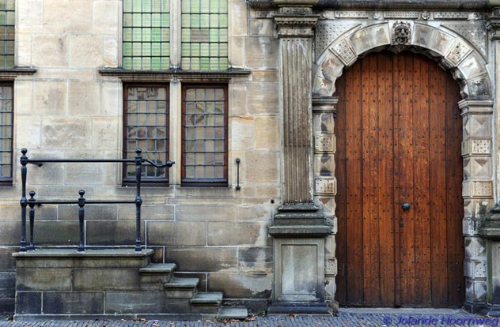
De roepstoel, Leiden

Slide 62
Instruction of Court Philips of Burgundy (1501) provided that:
‘… [the debtor] will be obliged, shortly after the approval, to come to … Leiden, and to stand in front of the town hall in their underclothing for three consecutive days, on an elevated platform, being three or four steps high, every day for an hour, namely from half past eleven to half past twelve in the afternoon, under pain of losing the effect of their letters of assignment lapsing.’
['… sy en sullen eerst ende alvoren gehouden wesen, corts na de interinatie van dien te koomen in onse voorschreve stede van Leiden, ende voor ’t stadhuys aldaer te stane in hoir onderste kleed, drie daegen achter een volgende, op een plaetse hoogh synde drie ofte vier trappen, elcken dach een uyre, te weten van half twaelven tot half een op de middach, op paene van te vervallen ’t effect van heure voorschreve brieven van cessie’]

Slide 64
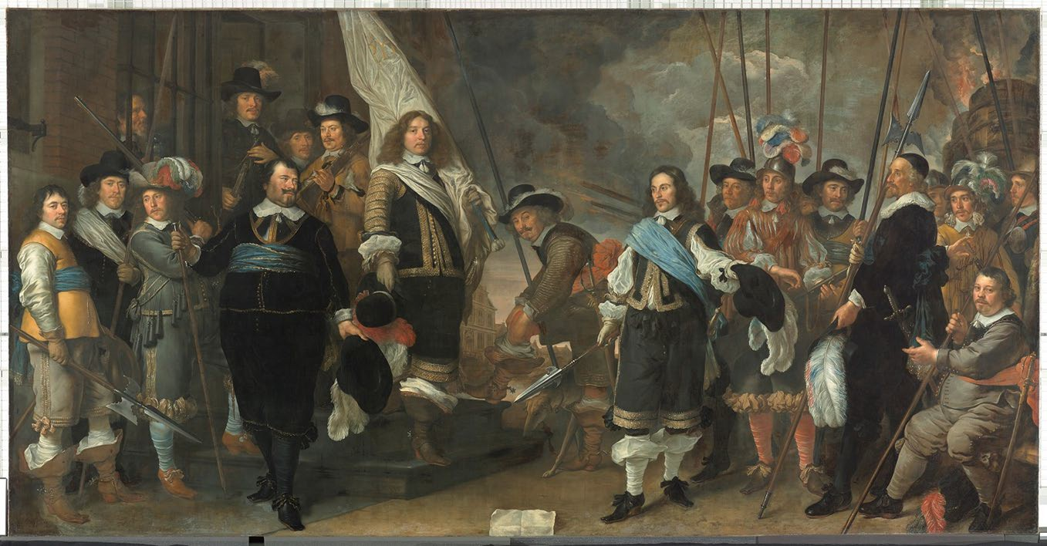
Govert Flinck, Schutters [Musketeers] van de compagnie van kapitein Joan Huydecoper en luitenant Frans van Waveren, 1648
[Amsterdam Museum]

Slide 65
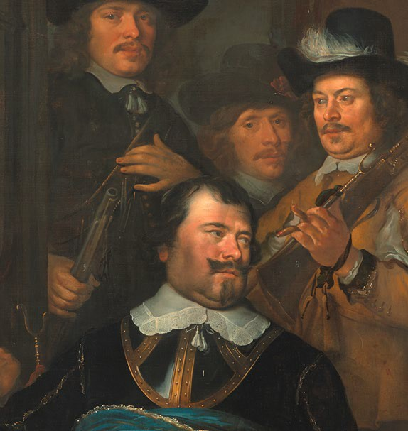
Frans Oetgens van Waveren, Commissaris Desolate Boedelskamer 1654

Slide 66
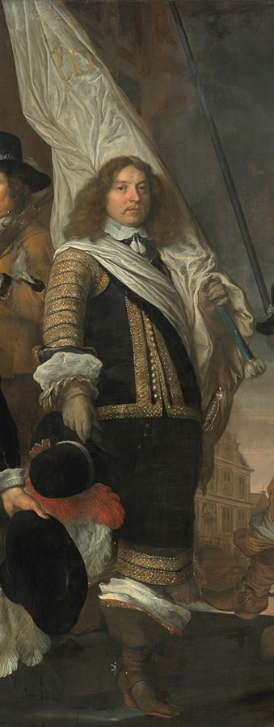
Nicolaes Oetgens van Waveren, Commissaris Desolate Boedelskamer 1656-
1661

Slide 67
Mr Aukema, Leiden:
inkomsten en uitgaven
Desolate Boedelskamer
dossier Rembrandt
verkopen | 12-9-1656 | fl 1.332,15 | kosten griffie DBK | fl 97,00
 | 21-11-1657 | fl 2.516,10 | aan C. Witsen | fl 4.180,00
 | 18-4-1658 | fl 432,05 | N. Kloeck/Thijs | fl -
 | 5-7-1658 | fl 95,15 | Hersbeecq | fl 4.200,00
 | 29-10-1658 | fl 126,10 | Gerincx | fl 175,17
 | 20-12-1658 | fl 80,00 | de la Tombe | fl 32,50
 | 20-12-1658 | fl 390,09 | Isaac Franck | fl 95,15
 |  |  | G. Schuirman | fl 130,20
 |  |  | aan Titus | fl 6.952,90
woonhuis |  | fl 11.218,00 | totaal | fl 15.862,92
 |  |  | kosten DBK | fl 326,72
totaal |  | fl 16.189,64 |  | fl 16.189,64

Slide 68
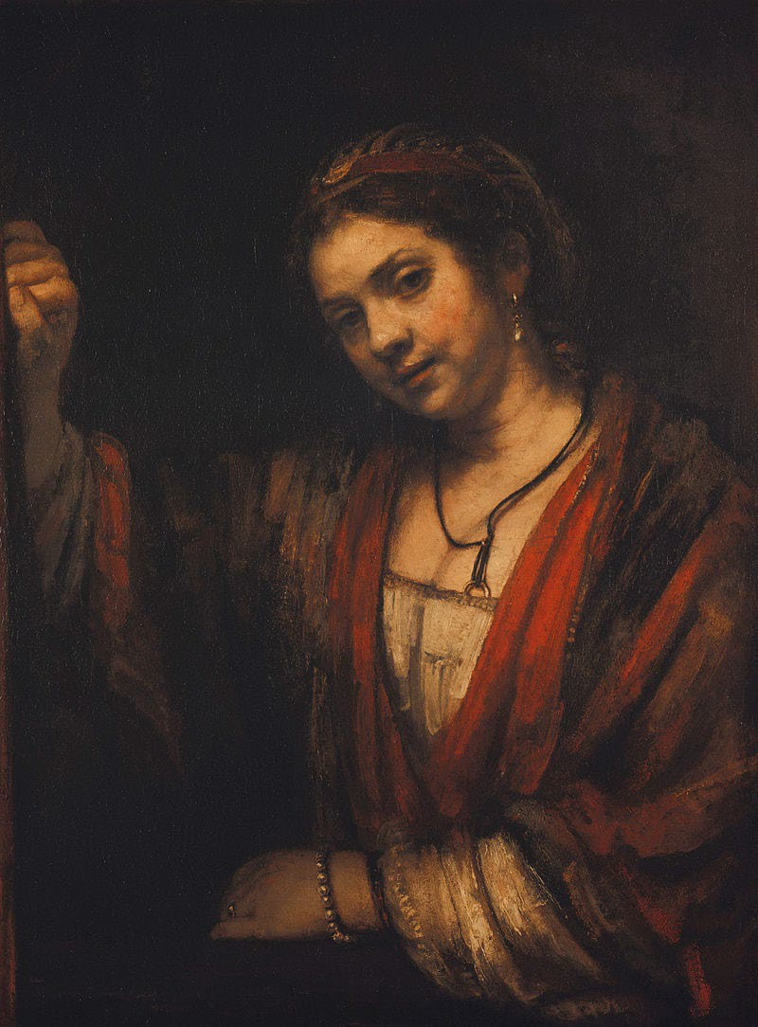
Hendrickje Stoffels (1626- 1663), 1656
1647: H becomes caretaker of Titus
1652 or 1654: birth of Cornelia
•
1654: Reformed church banned Hendrickje from receiving communion (‘de tafel des Heren’) because of fornication (‘hoererij’).

Slide 69
Den 15 December 1660 compareerden Titus (van Rhijn), geassisteerd met Rembrandt van Rhijn, sijn (vader ter) eenre, en Hendrickje Stoffels meerderjarigh, voor soo veel (noodig met) haer gecooren vooght ten desen geassisteerd ter andere sijde en verclaerden overeengecomen ende verdraghen te sijn over seeckere compagnie en handel van schilderijen, papiere kunst, kooper- en houtsnede, item drucken van deselve, rariteyten en alle ap- en dependentien van dien, als sijlieden met malcanderen voor langer als twee jaren hebben aengevangen en vervolgens noch wilden continueeren tot soo lange toe als de voorsz. Rembrandt van Rhijn int leven sal wesen, en noch ses jaren daer naer, en dat op de volgende conditien

Slide 70
[15 December 1660 Hendrickje and Titus] declare to have contracted and agreed (‘verclaerden overeengecomen ende verdraghen te sijn’) that they had a cerain company and had traded (‘seeckere compagnie en handel’) in paintings, graphic arts, engravings and woodcuts, as well as prints, curiositues, and all related objects (‘van schilderijen, papiere kunst, kooper- en houtsnede, item drucken van deselve, rariteyten en alle ap- en dependentien van dien’), a trade which they began doing jointly more than two years ago and desire to continue as long as Rembrandt is alive, and for six years, thereafter (‘als sijlieden met malcanderen voor langer als twee jaren hebben aengevangen en vervolgens noch wilden continueeren tot soo lange toe als de voorsz. Rembrandt van Rhijn int leven sal wesen, en noch ses jaren daer naer’). They will do so according to the following conditions:

Slide 71
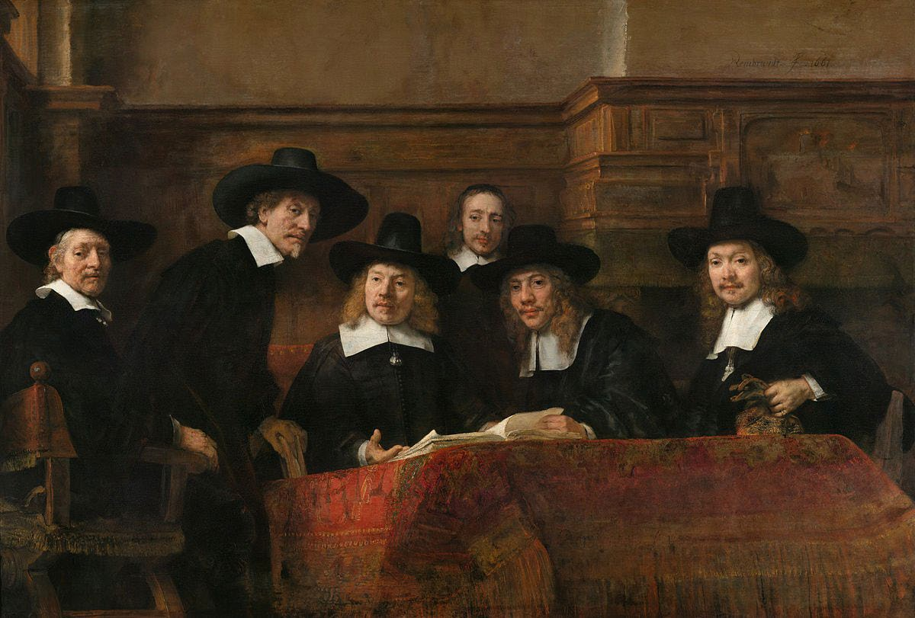
De Staalmeesters, 1662
The Wardens of the Amsterdam Drapers’ Guild, known as ‘The Syndics’

Slide 73
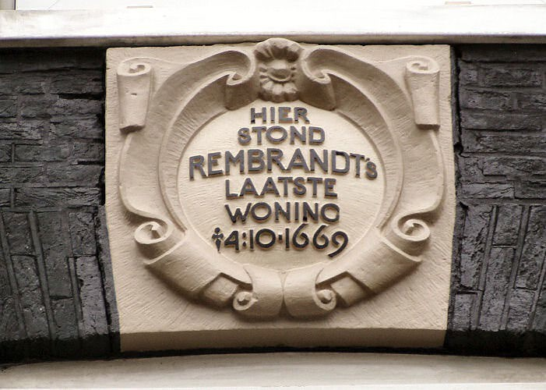

Slide 74
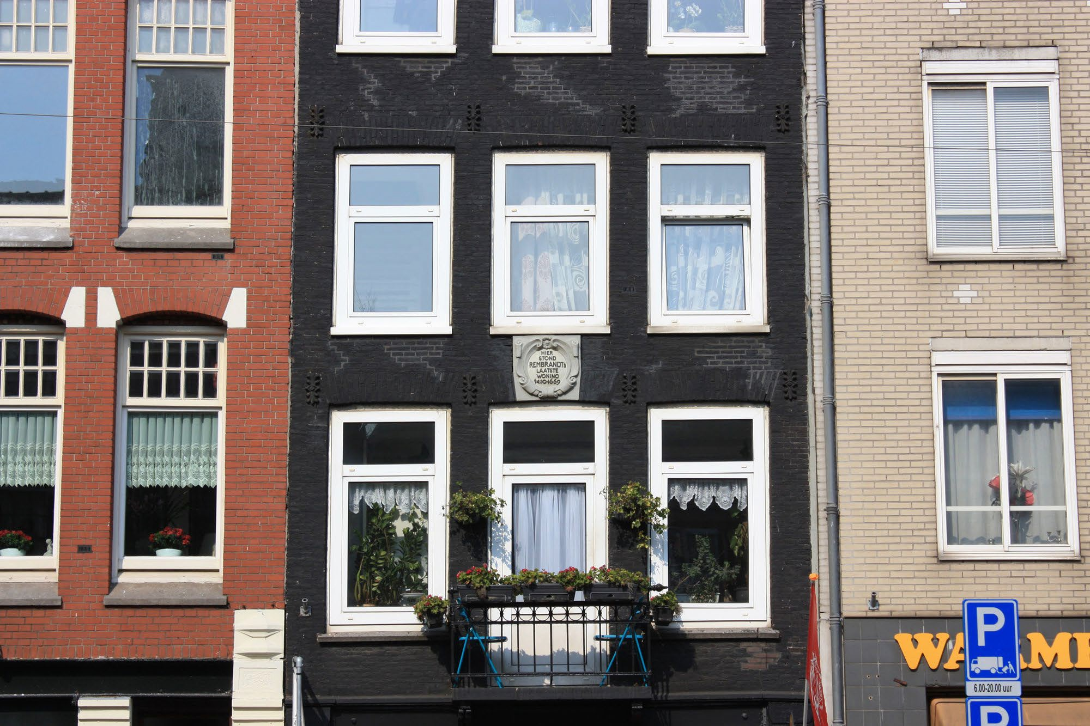

Slide 75
‘AntiekTattoo is a tattoo shop and an art gallery located on the Rozengracht 184, right in the city centre of Amsterdam. We are situated in the last residency of Rembrandt van Rijn, one of Holland’s most famous painters. Because of this very special location and our own dedicated team of artists Antiek tattoo breaths a very special atmosphere’.

Slide 76
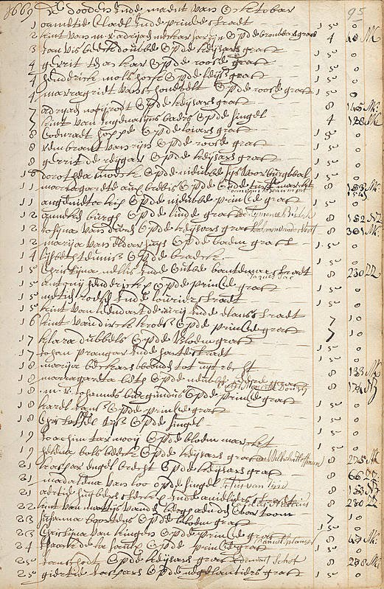

Slide 77
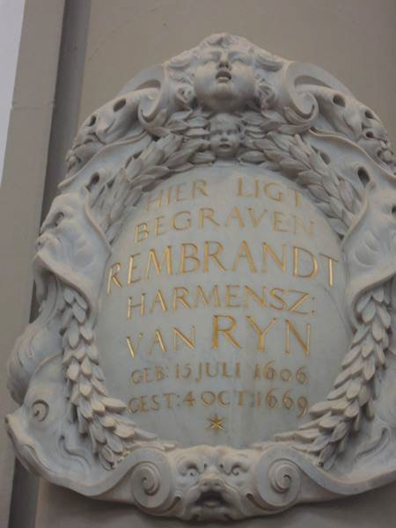

Slide 78
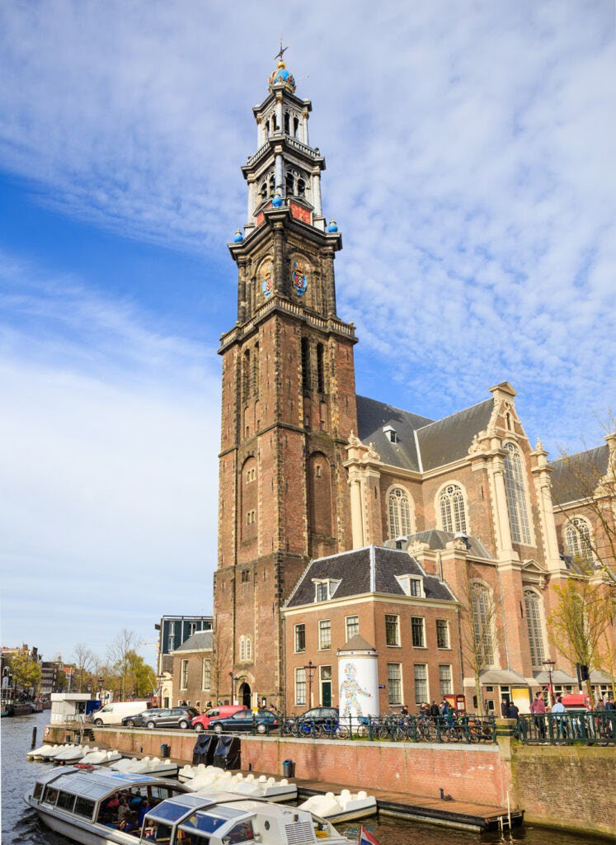

Slide 79
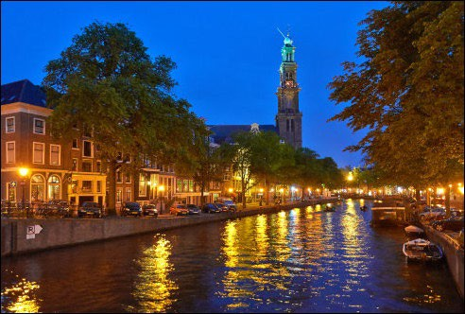

Slide 81
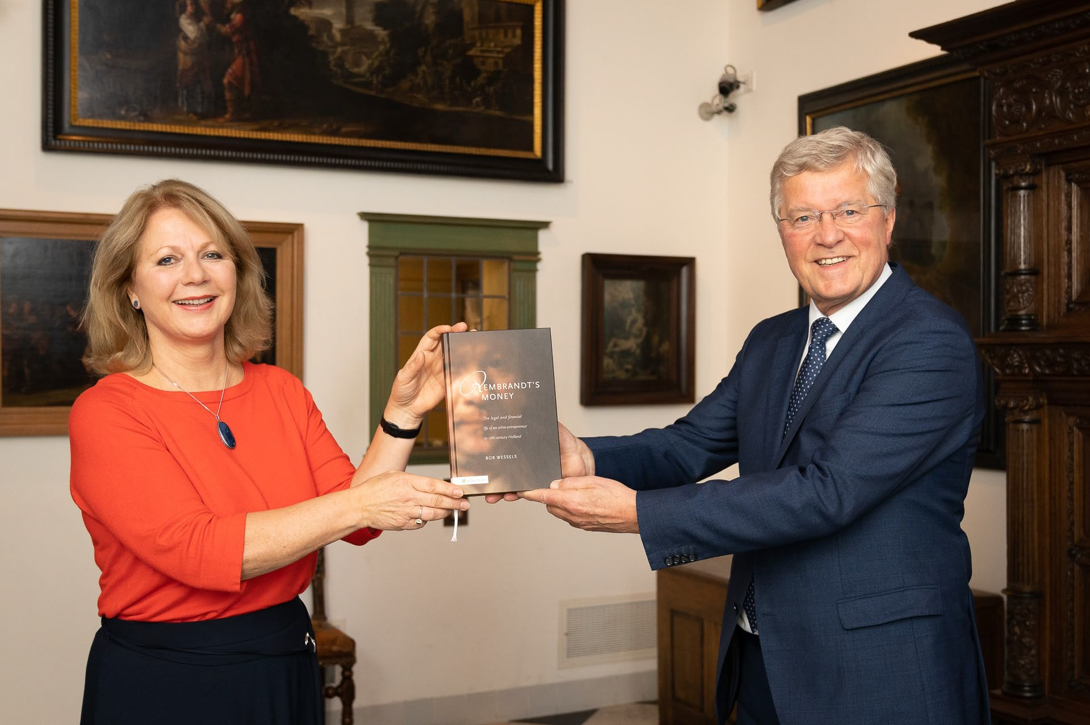

Slide 82
bwessels@bobwessels.nl
www.bobwessels.nl
82

